Slide 1


Week 3 - Group Homework - Designing console layouts
Screen Consoles and Attachment
Del Rosario, Michael Gabriel
Gonzaga, Eros
Kimhoko, Jamuel Erwin
Magdamo, Bien Rafael
1

Slide 2
Concept
Screens are treated as individual objects of its own class.
A main loop of the emulator is employed, where re/attaching a screen will pause this main loop and switch to that of the respective screen’s. These are treated as states that lock in upon the re/attachment or exiting of a screen.
The screen’s loop should handle all pertinent function calls and command inputs for its process or operation (i.e. screen creation command).
A screen should display the minimum information: process name, timestamp of creation, command line being processed.
Nested screens are possible, in which another screen can be re/attached from within a currently attached screen.
2

Slide 3
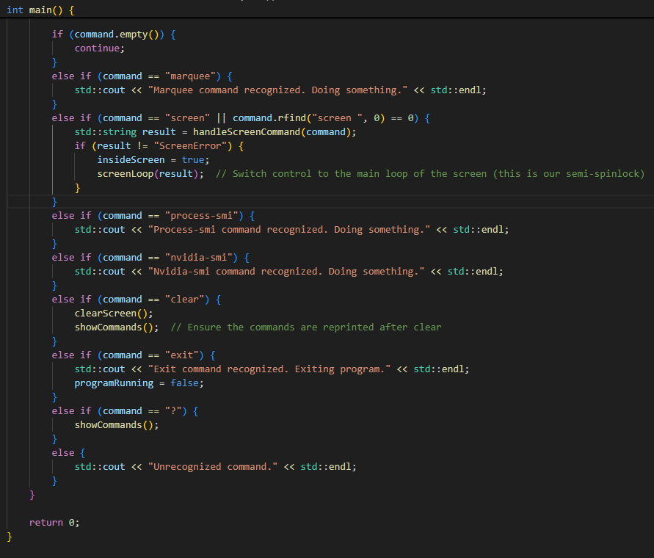
Main Loop
Handles the commands supported from the main loop, as listed.
Prints the emulator’s header and command list upon bootup by calling showCommands().
Transfers control to the loop of a re/attached screen upon inputting its respective command.
Calling handleScreenCommand() processes the screen command by tokenization.
2

Slide 4
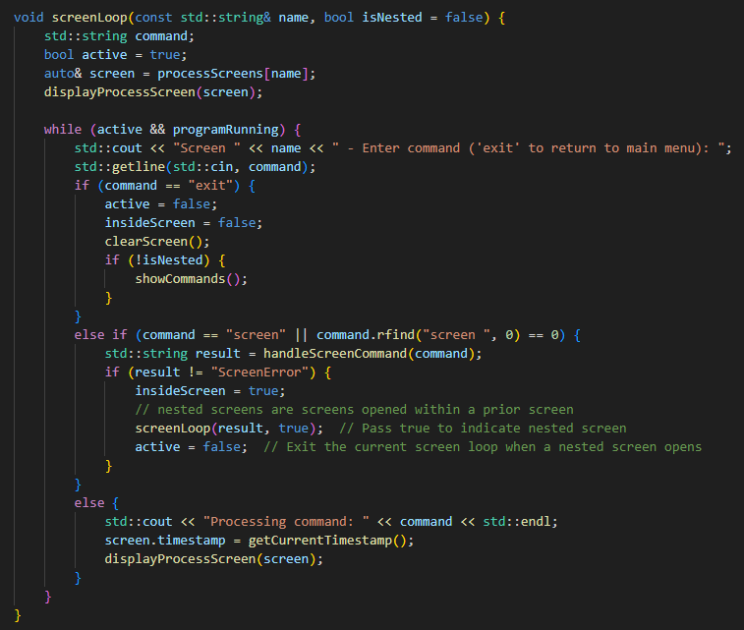
Screen Loop
exit returns the control to the main loop.
screen -r or -s <name> re/attaches a screen, respectively.
A function call displayProcessScreen(screen) handles the displaying of the console information of the screen.
An input command is assumed and processed through a placeholder print (“Processing command: “).
2

Slide 5
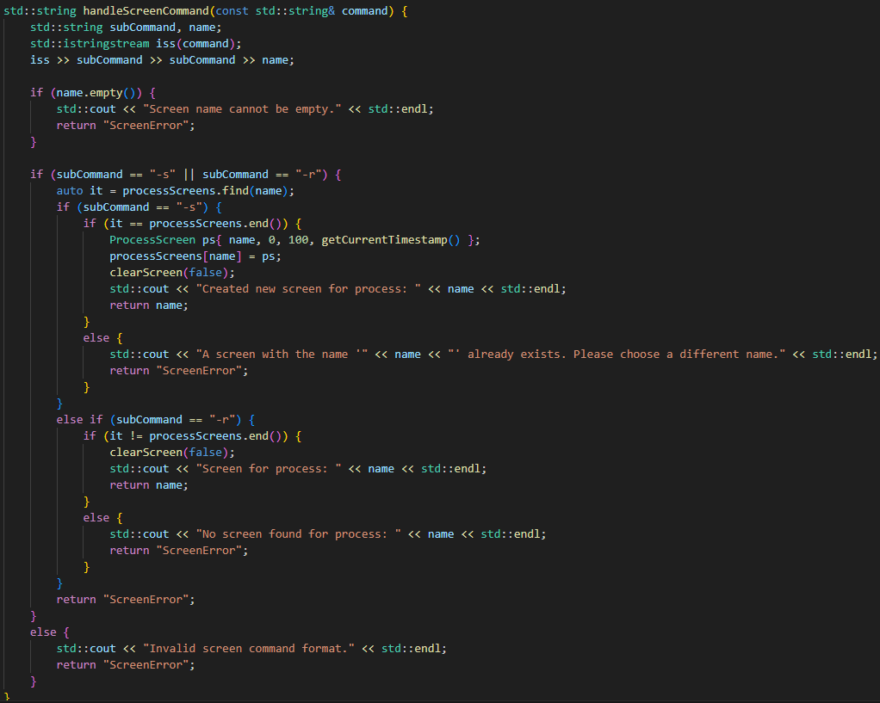
handleScreenCommand
Tokenizes the screen command, extracting its parameters.
The tokens or parameters are mapped to its respective operation (re/attachment).
Extracts the name token or parameter.
Handles errors regarding command syntax.
Prevents duplication of existing screens.
2

Slide 6
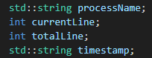
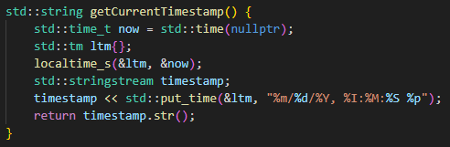
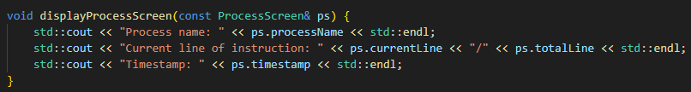
Miscellaneous
Bare minimum information of screen consoles.
Get timestamp.
Displaying screen console information.
2

Slide 7
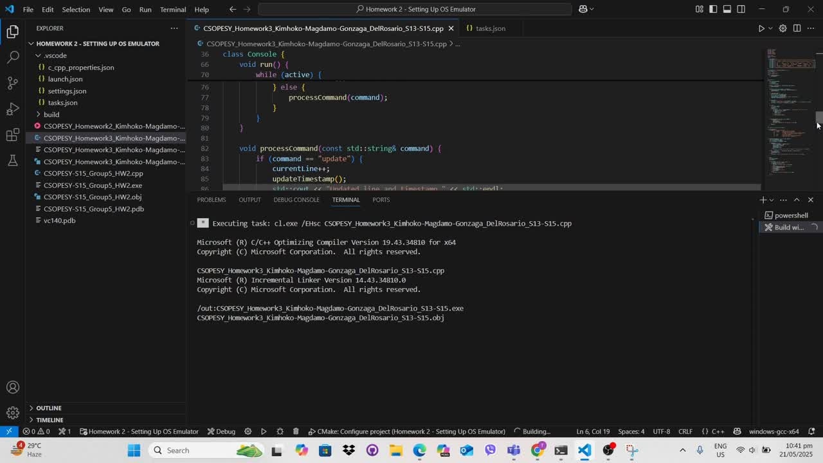
Demonstration Recording
3

Slide 8
Week 3 - Group Homework - Designing console layouts
Thank You!

